Slide 1

tourist guide (Dilli Mate)
BY-
DARSHIT CHAUDHARY
UNIVERSITY ROLL NO.-2000380140013
MCA 2ND YEAR
BATCH 2020-22
Under the supervision of
prof. ABHAY KUMAR RAY

Slide 2
INTRODUCTION
The topic of our project is Tourist Guide for Delhi(DilliMate). This Tourist Guide website will help to make tourist experience better and memorable with handy facilities at a single place.
This website will help users to know their nearby hotel and to select them as per their convenience. It’ll also help the tourist vloggers and bloggers to explore amazing location and Delicacies via accessing a single platform.
It include healthcare section which help the user in case of emergency at a new place. we’ve also included cab & guide facility in order to get the full tour of city.

Slide 3
Problem Statement
The existing websites that we have currently does show options for the travelers but isn’t a fulfilling enough. Well normally, the tourists or basically any person with a ‘fish out of water’ tag on their back, had either to rely on the old timer ways to get to their destination’s in a foreign place, by asking for directions or asking the officials or even if they has a GPS system or any other location guide software on their device they would still be running a constant fear of falling into Single Point Failure whenever the servers went down, which they will at one point or other.
Though our project tourist guide that me named as Dilli Mate, will be a one stop destination for all the tourists out there to get numerous options at single website by just one signup.

Slide 4
PRODUCT FEATURES
This system has following features –
-> To make tourist Experience better & memorable.
->To check the availability of hotel room.
->To check the good tourist spots.
->Get the facility of healthcare & Restaurants.
->Registered user gets the recommendation of the places of their preferences.
->They can find the places using this system.
->User can easily view the place on website with its description, image and address.
->The system also provides one food place in the results.
->System GUI is easy to use.

Slide 5
USER CLASSEs
The main idea of our project is one should get all necessary facilities detail at a single platform is when visiting some new places and cities. criteria should be simple and natural, like : a list of museums, the most famous historical objects, restaurants to visit, constraints to travel by bus and by walking. The system should find a path that fulfills those criteria show names of objects, some short descriptions and photos of them and possible entrance costs. It should also be able to estimate time needed to travel from one object to the next and if it is possible, It should be helpful for people that want to visit a city without having much information about it.
Tourists
Vlogger
Blogger

Slide 6
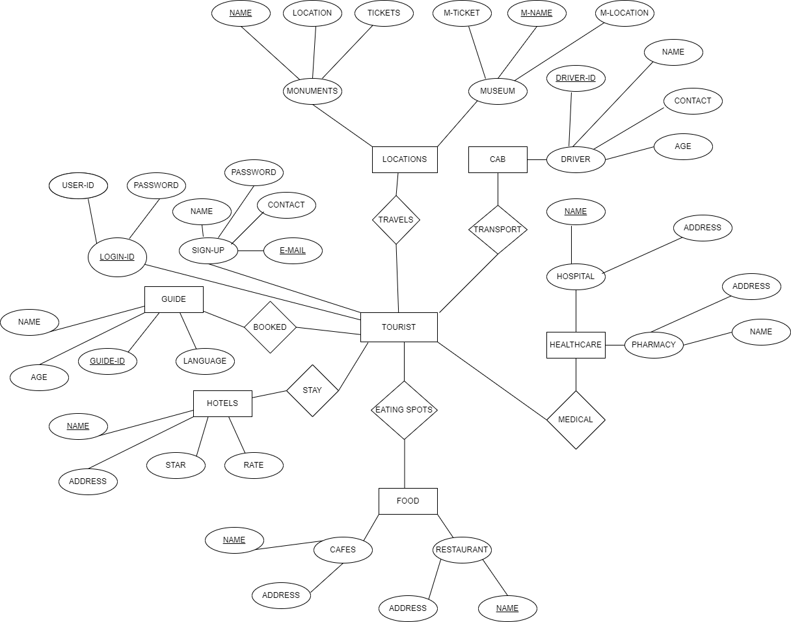
ER DIAGRAM of tourist guide

Slide 7
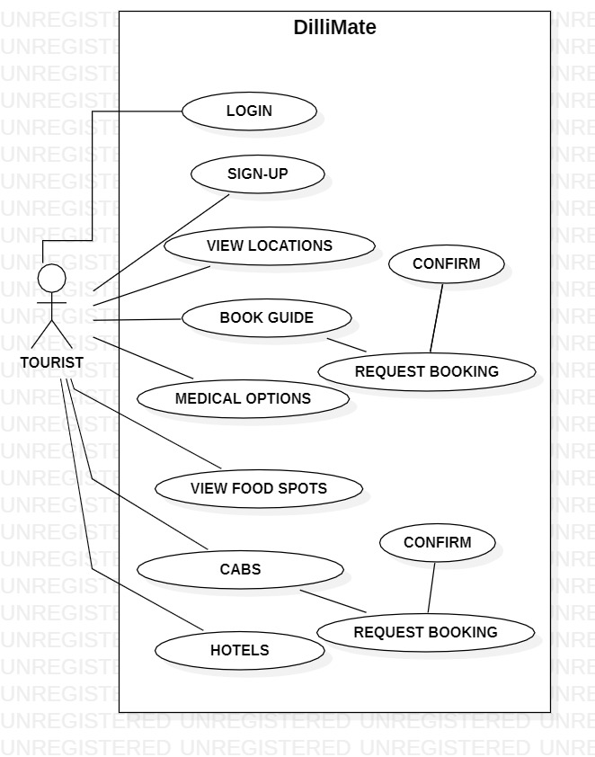
Use case diagram

Slide 8
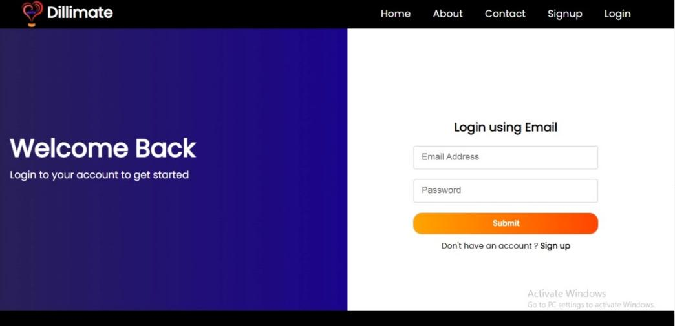
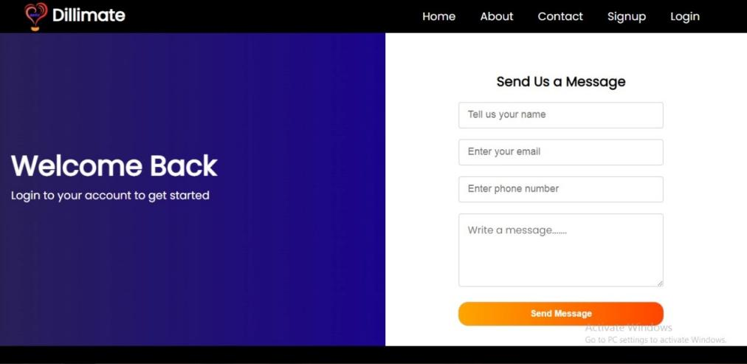
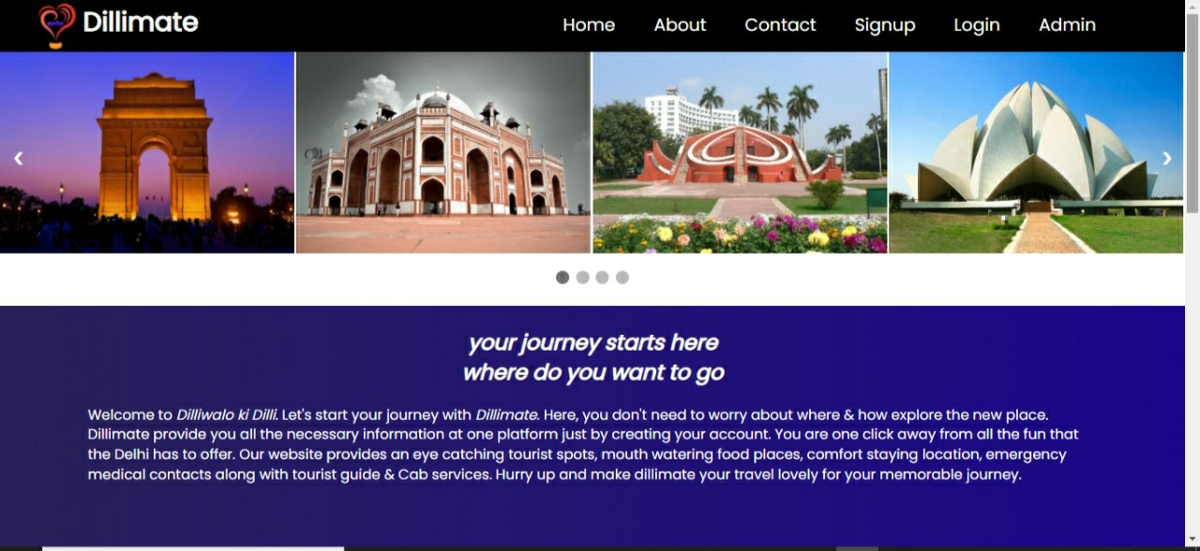
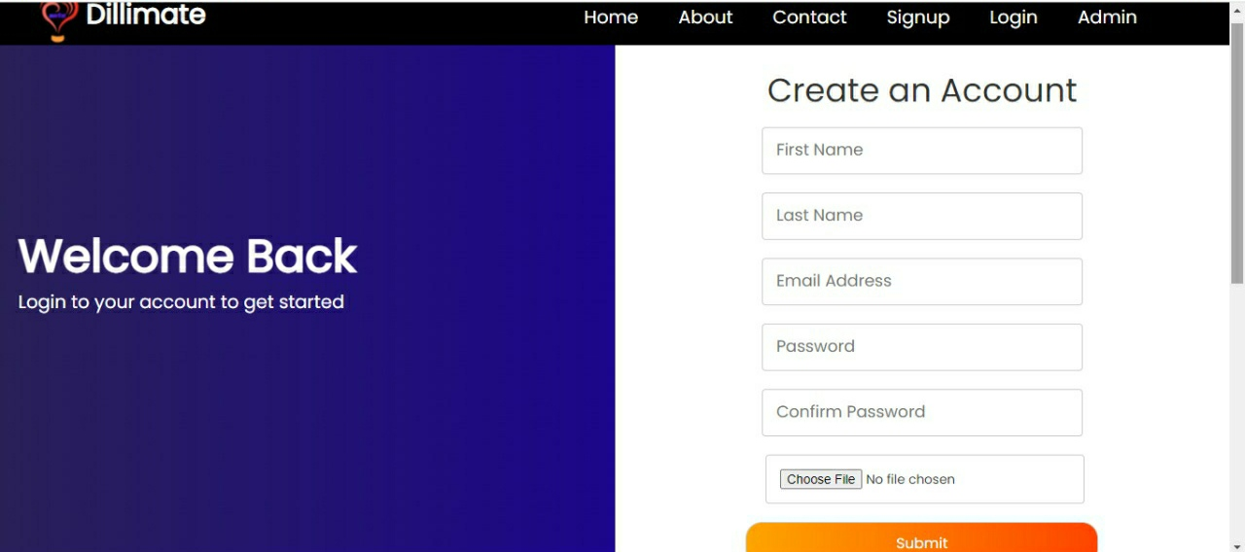
USER INTERFACES

Slide 9
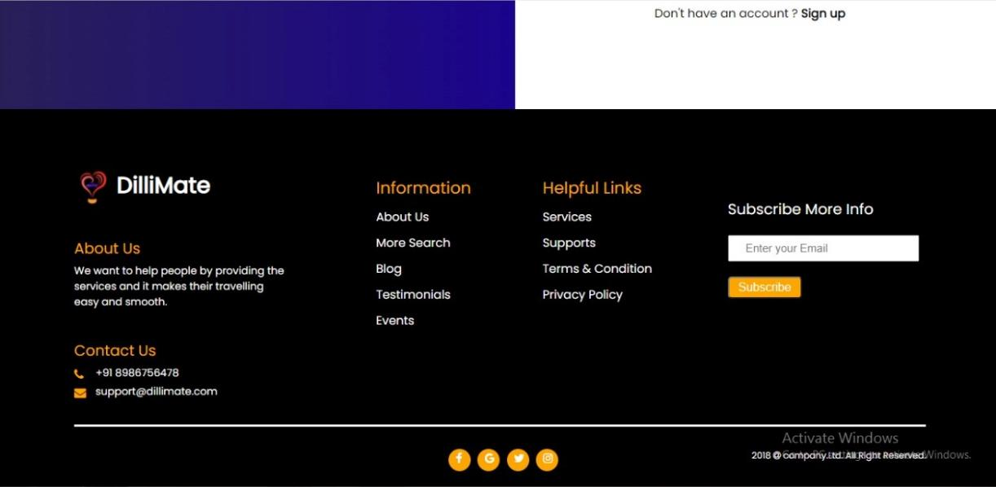
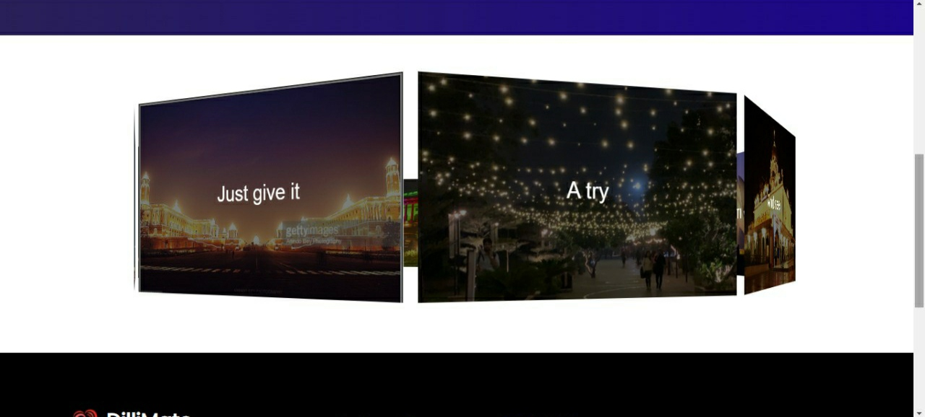
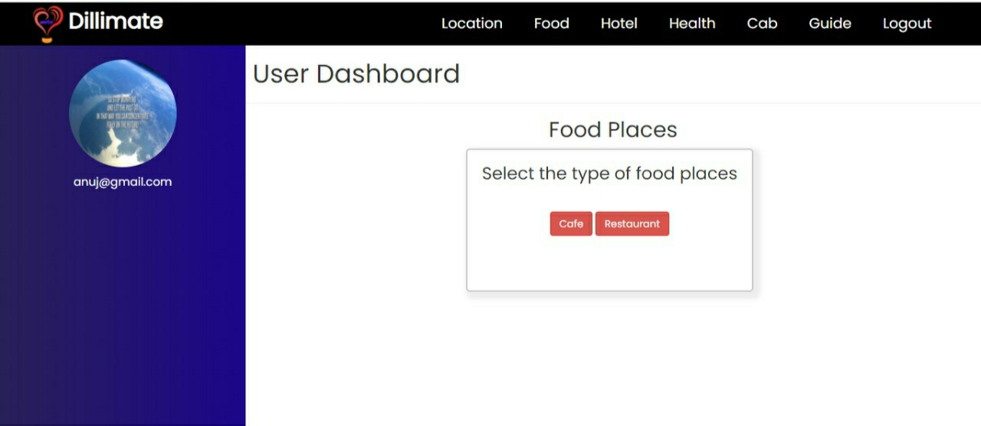

User module

Slide 10
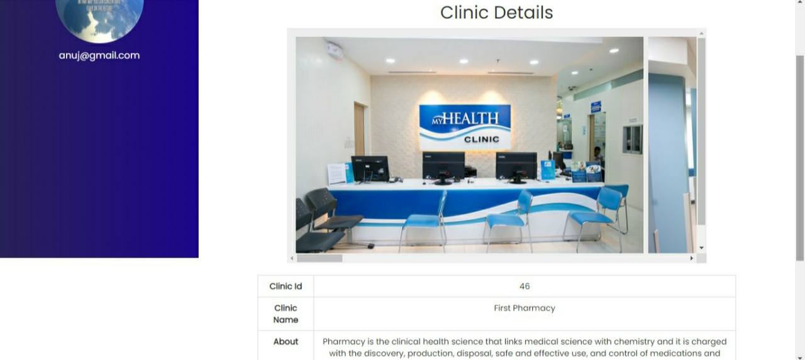
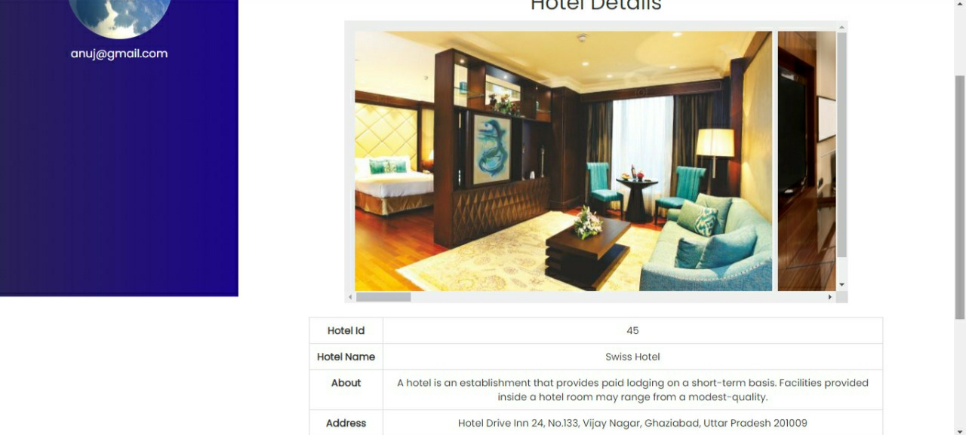
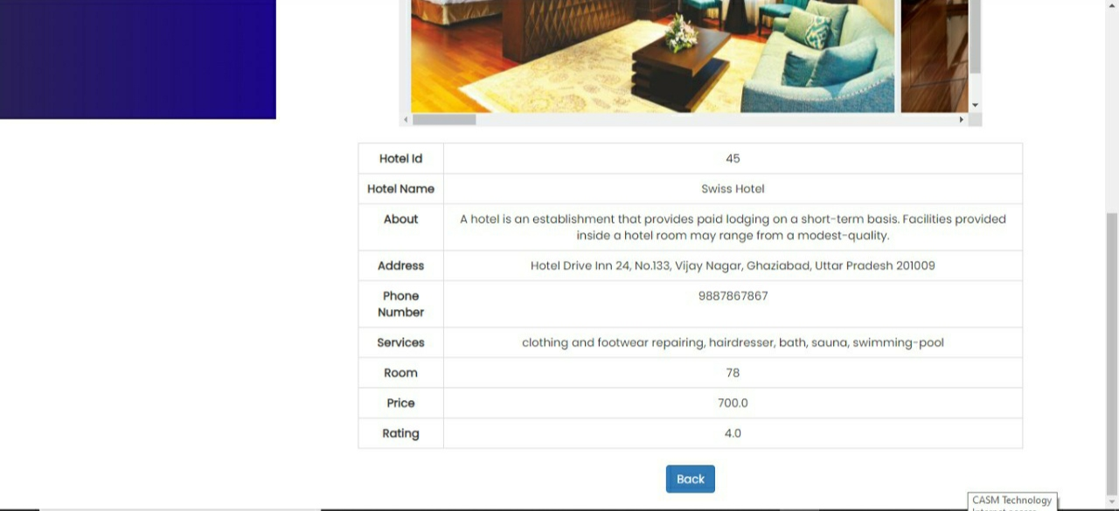
User module

Slide 11
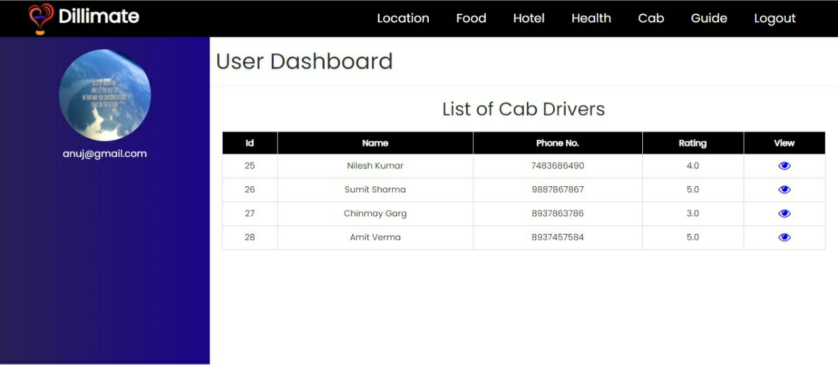
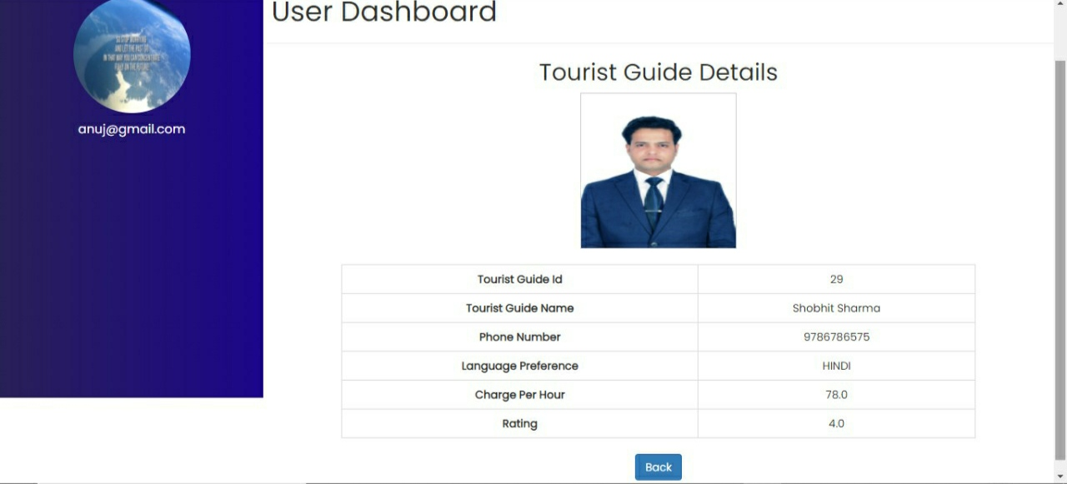
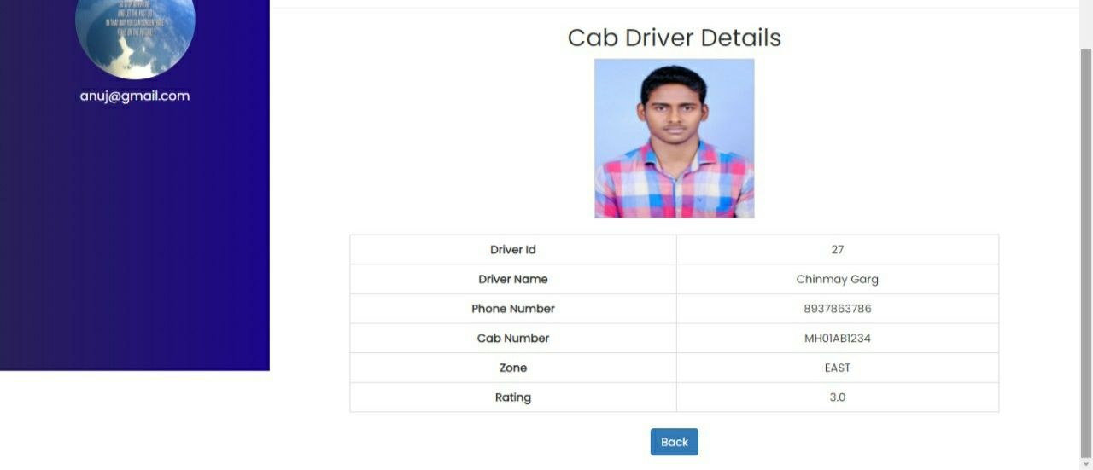
User module

Slide 12
Future Scope of the Project
Based on the current limitations of our project, there can be some recommendations to improve the features of our app in order to make it more user friendly, efficient and effective as well.
->Real Time Interactive Conversation: The conversation in hotels, buses and
restaurants are to be real time interactive through instant language translations.
->GPS Location Tracker: Instead of giving use’s current location to the map, the
User’s location will be automatically followed by GPS location tracker which will make the
app more powerful and systematic.
->More Detailed Routing Information: More details of routing information nearby
areas in the city can be provided to the user.
-> Whole Country Coverage: As we are using Google’s map for locating user’s
destination and finding the route information, this app can be implemented for the entire
country coverage.

Slide 13
CONCLUSION
Keeping travellers need in consideration and the current trend, we have developed our Tourist Guide Application. The application is able to meet most of the requirements that is commonly asked by the travellers, Besides, the simplicity of using the application has been maintained. The app can be helpful for travellers who are the newcomers to the Delhi.

Slide 14
REFERENCES
https://www.eclipse.org/
https://www.google.com/search?q=documentation+for+tourist+guide+project&ei=qHPiYbGzC8G0mgfx0Jj4Cw&oq=documentation+for+tourist+guide&gs_lcp=Cgdnd3Mtd2l6EAEYADIICCEQFhAdEB4yCAghEBYQHRAeMggIIRAWEB0QHjIICCEQFhAdEB46BwgAEEcQsAM6BQgAEIAEOgYIABAWEB46CAgAEBYQChAeOgYIABANEB46CAgAEA0QChAeOgQIIRAKSgQIQRgASgQIRhgAUP8BWNA9YMlLaARwAngAgAG_AYgB4ROSAQQwLjE3mAEAoAEByAEIwAEB&sclient=gws-wiz
https://www.researchgate.net/publication/281490309_Android_Application_Travel_Guide
https://www.google.com/search?q=analysis+for+tourist+guide&gs_ivs=1
https://nevonprojects.com/intelligent-tourist-guide/

Slide 15


